Slide 1

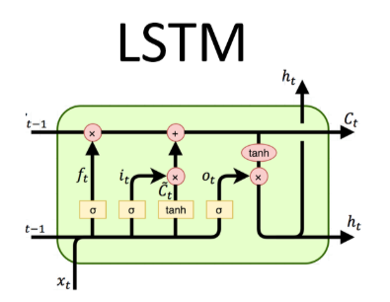

Presenting the project titled Text Classification LSTM TensorFlow

Slide 2
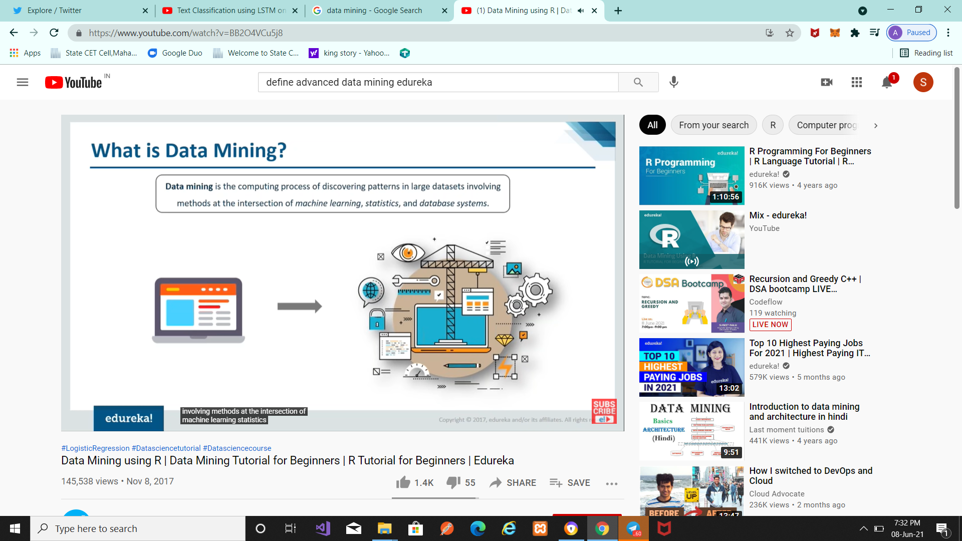
What is data mining ?

Slide 3
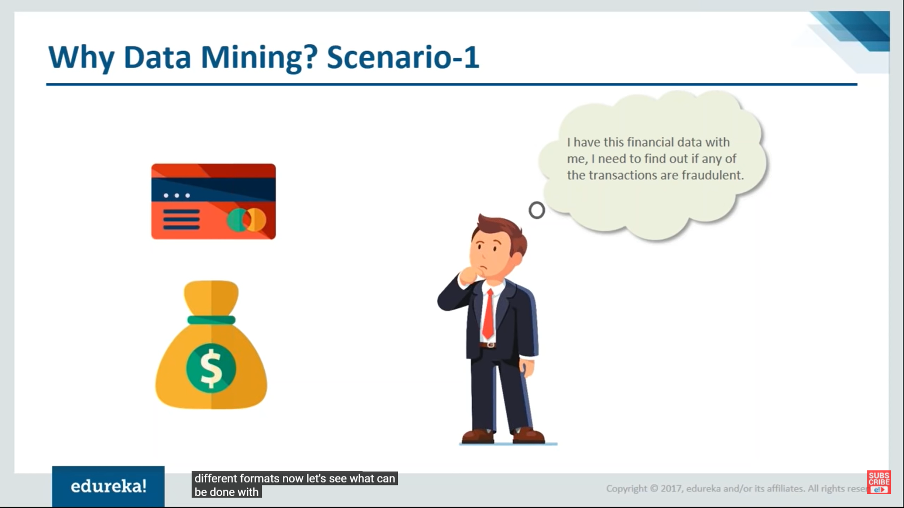
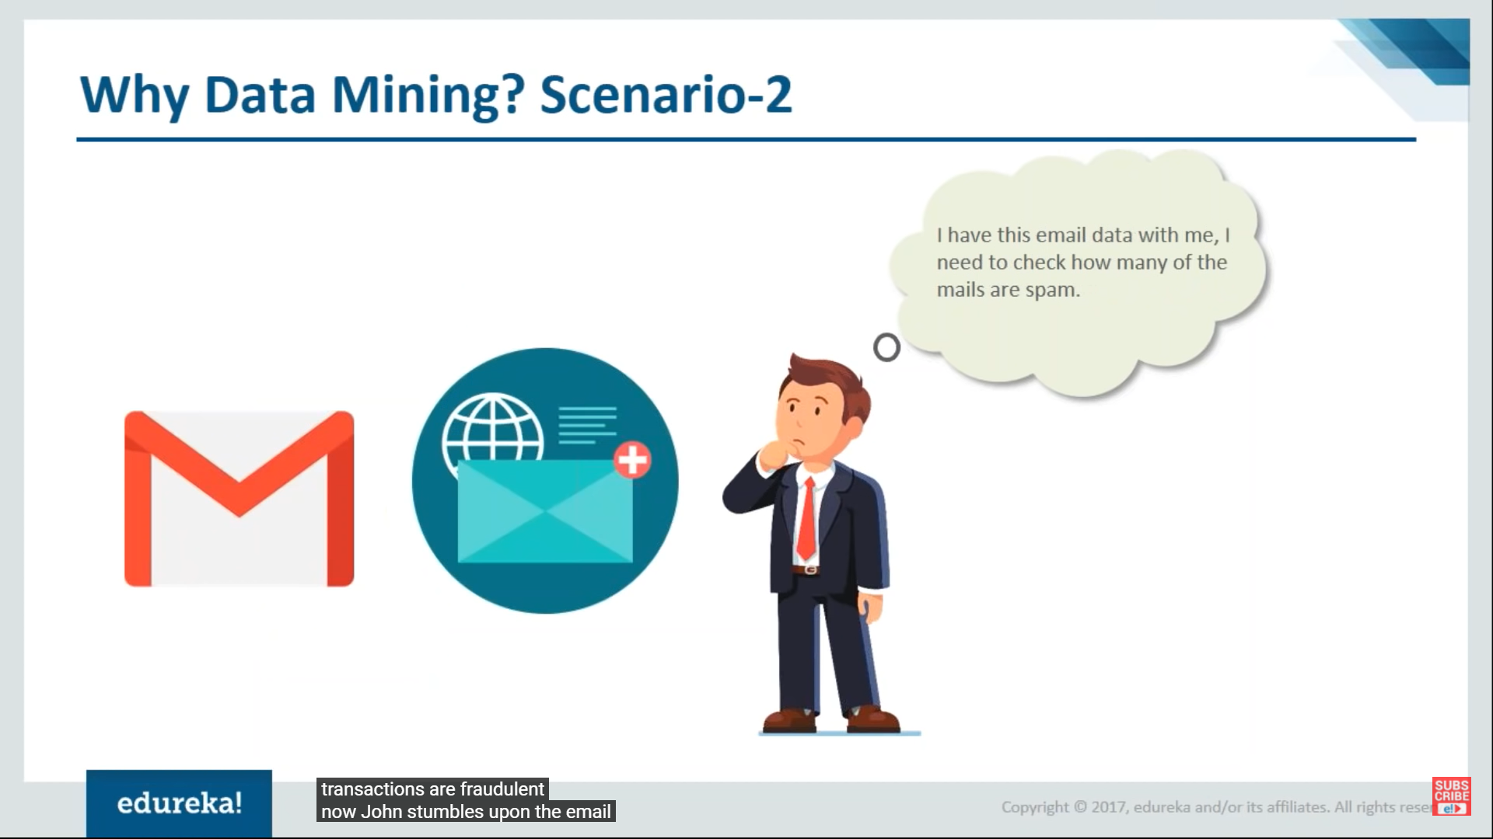
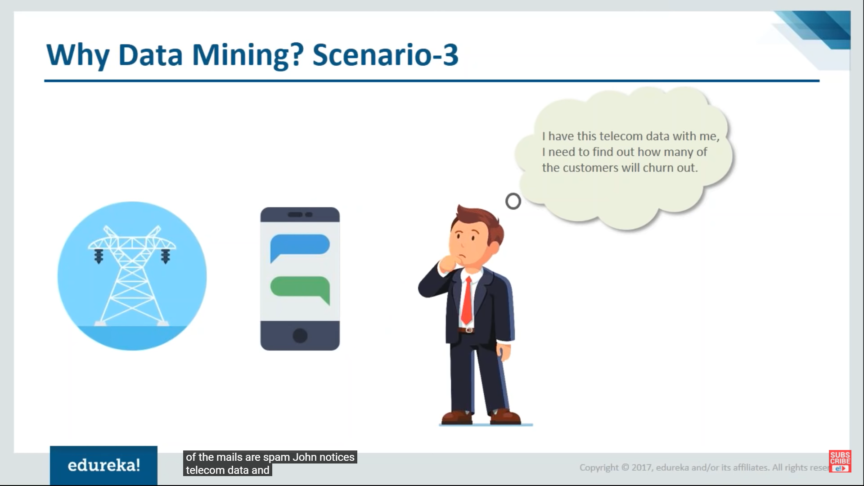

Why Data Mining ?

Slide 4
Introduction to Project -
How we can implement text classification with Tensorflow.
Perform sentiment classification by considering reviews which have rating 3(3,4,5) and above as having positive sentiment and reviews having ratings below 3(1,2) as negative sentiment.
Develop a LSTM based classfication model for sentiment classification on review data.
The dataset is from Amazon Review Data.
Cell Phones and Accessories review dataset from "Small" subsets for experimentation.

Slide 5
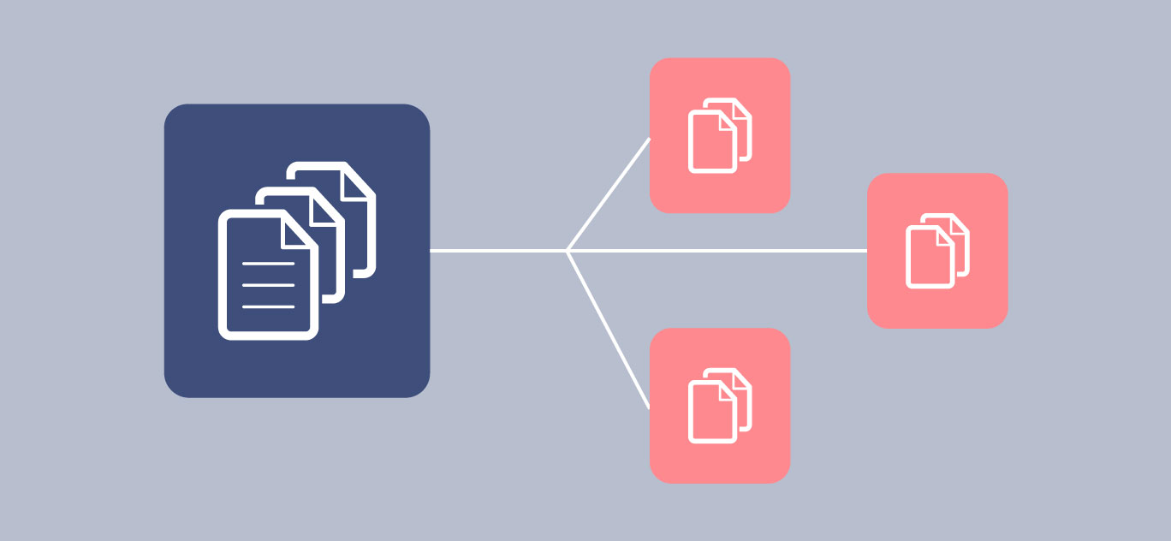
What is Text Classification ?
Text classification also known as text tagging or text categorization is the process of categorizing text into organized groups.
Text classifiers can automatically analyze text and then assign a set of pre-defined tags or categories based on its content.

Slide 6
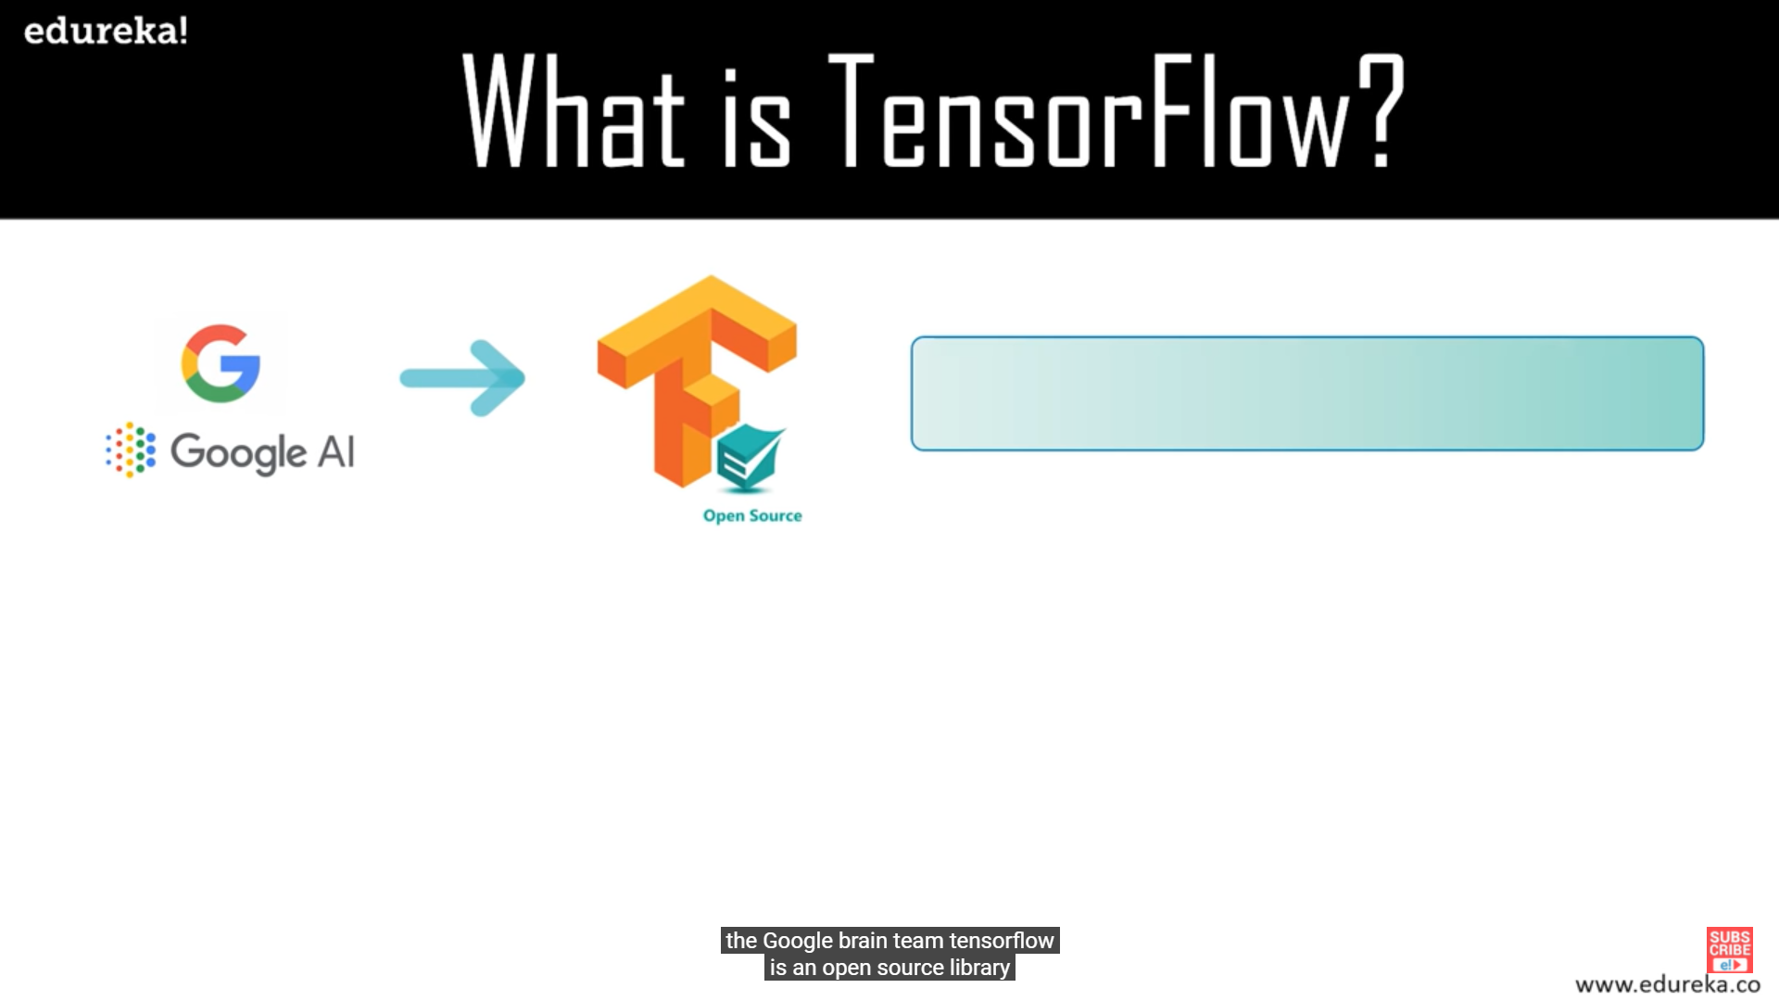
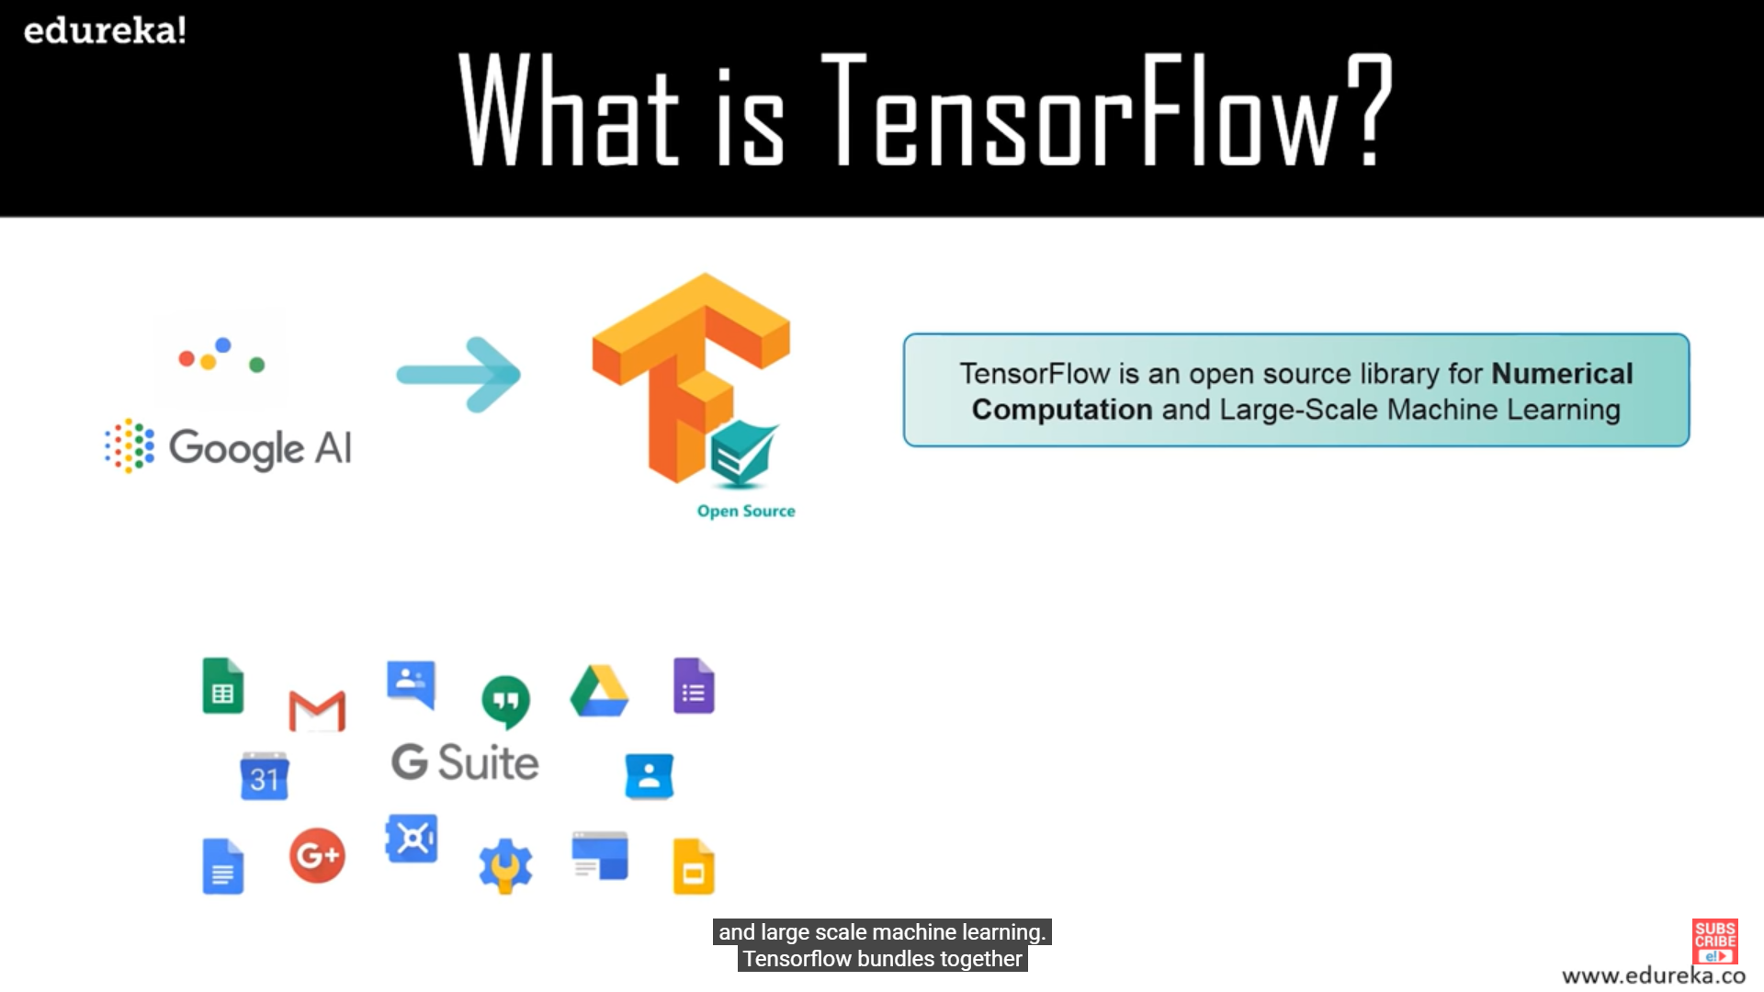

What is TensorFlow ?

Slide 7

Companies using TensorFlow -

Slide 8

Features of TensorFlow
Why TensorFlow ?
• TensorFlow is an end-to-end open source platform for machine learning. • It has a comprehensive, flexible ecosystem of tools, libraries and community resources that lets researchers push the state-of-the-art in ML and developers easily build and deploy ML powered applications.

Slide 9
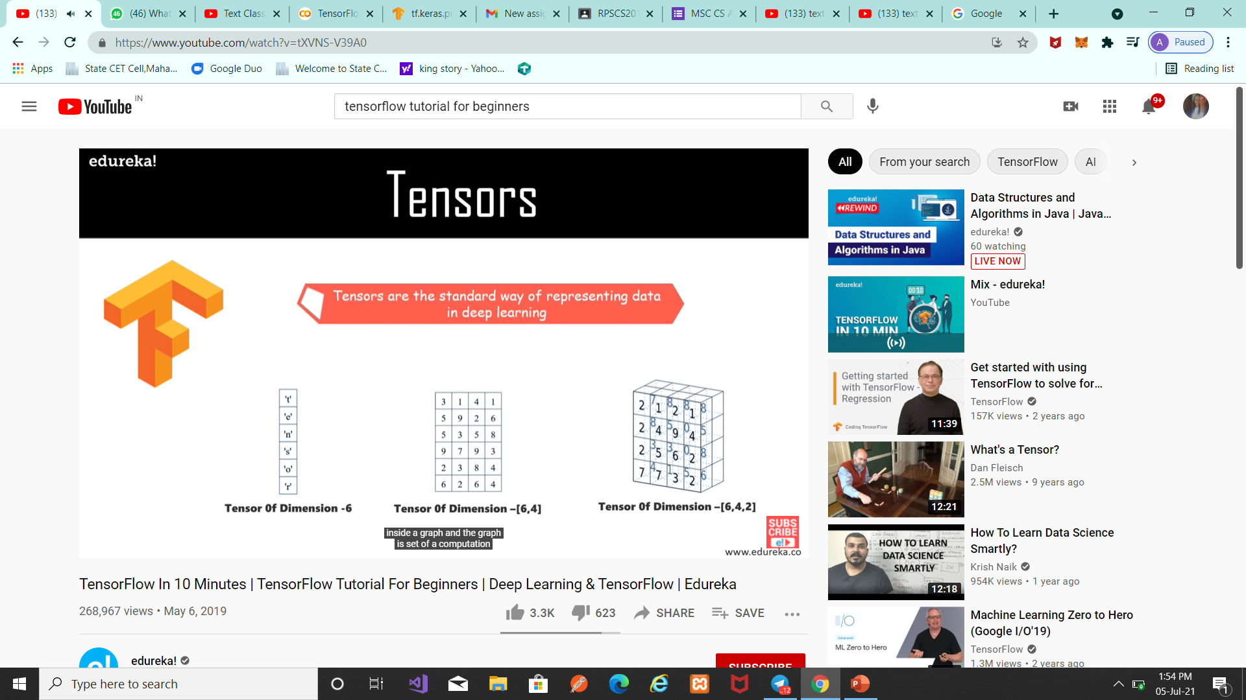
Tensors

Slide 10

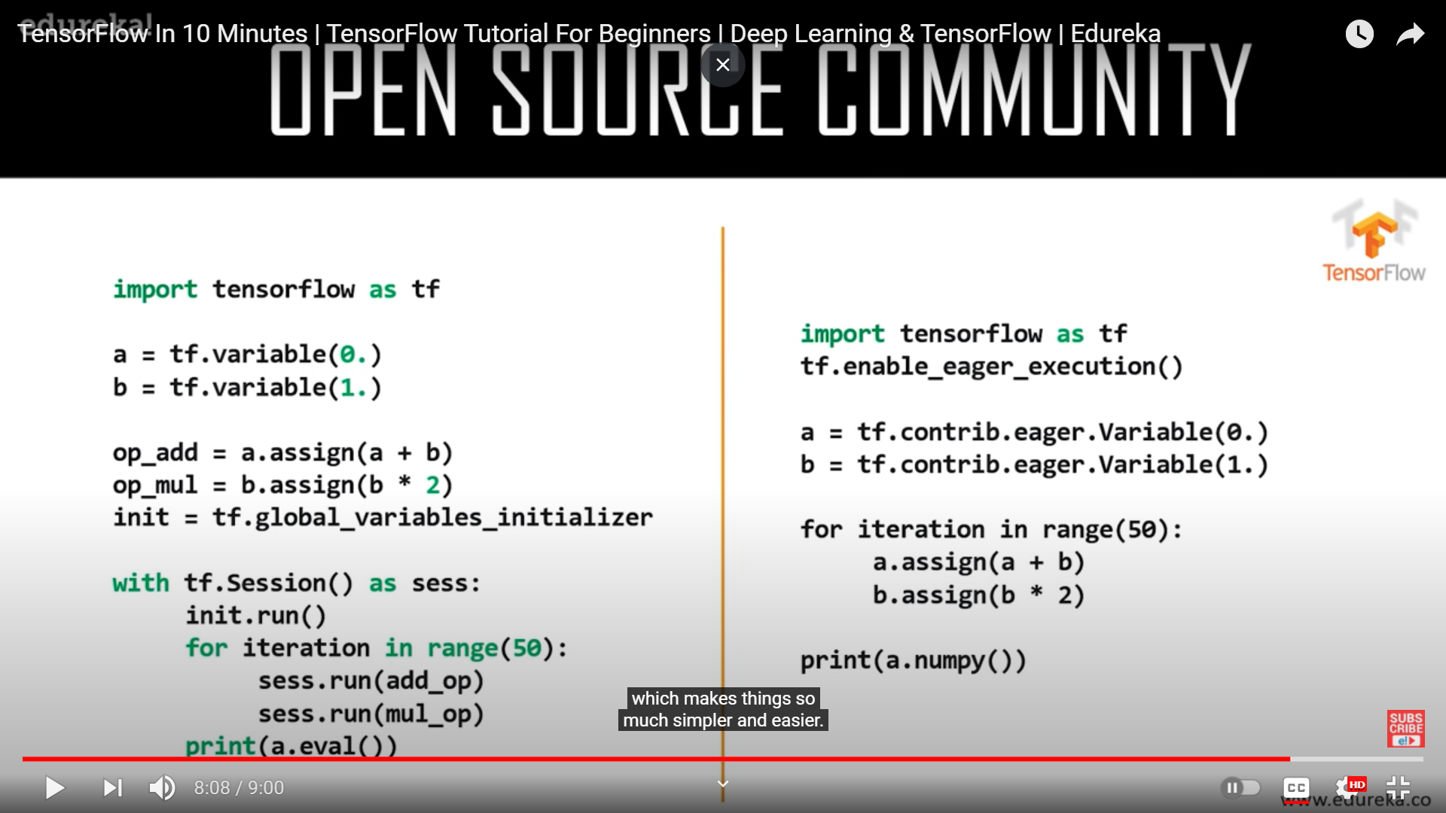
Open Source Community

Slide 11
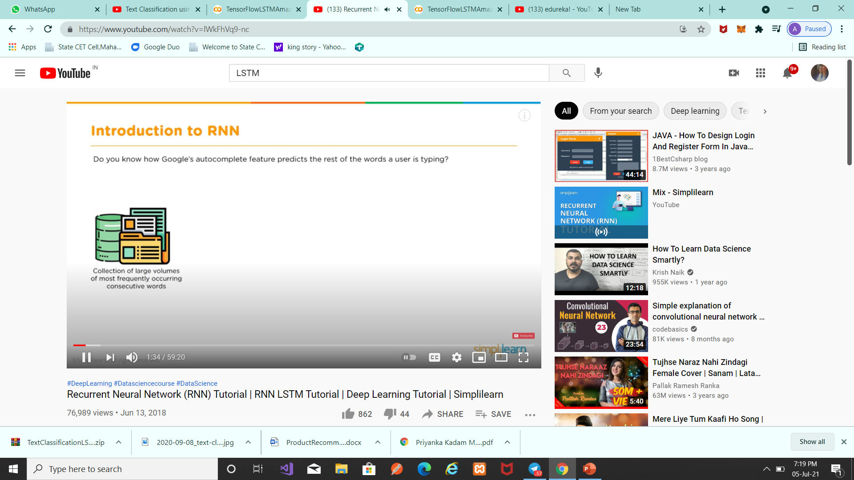
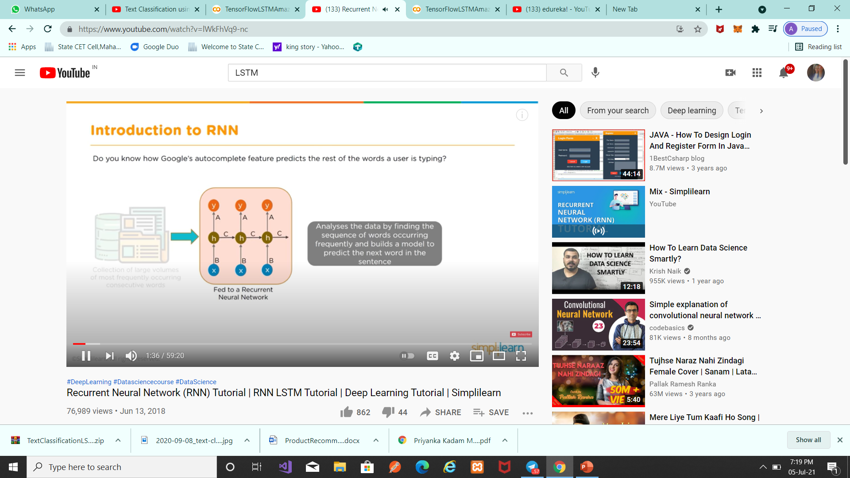
Introduction to RNN
Recurrent Neural Network
Recurrent Neural Network(RNN) are a type of Neural Network where the output from previous step are fed as input to the current step.

Slide 12
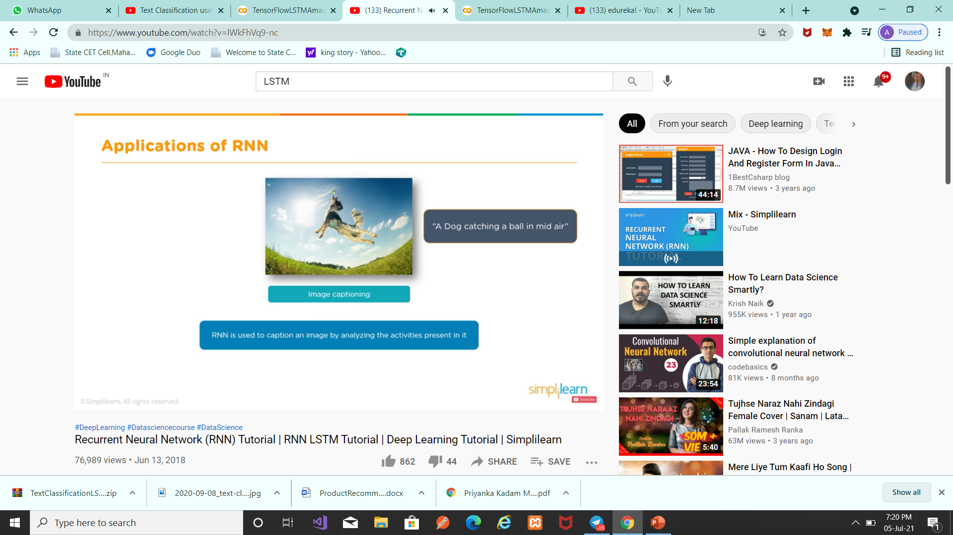
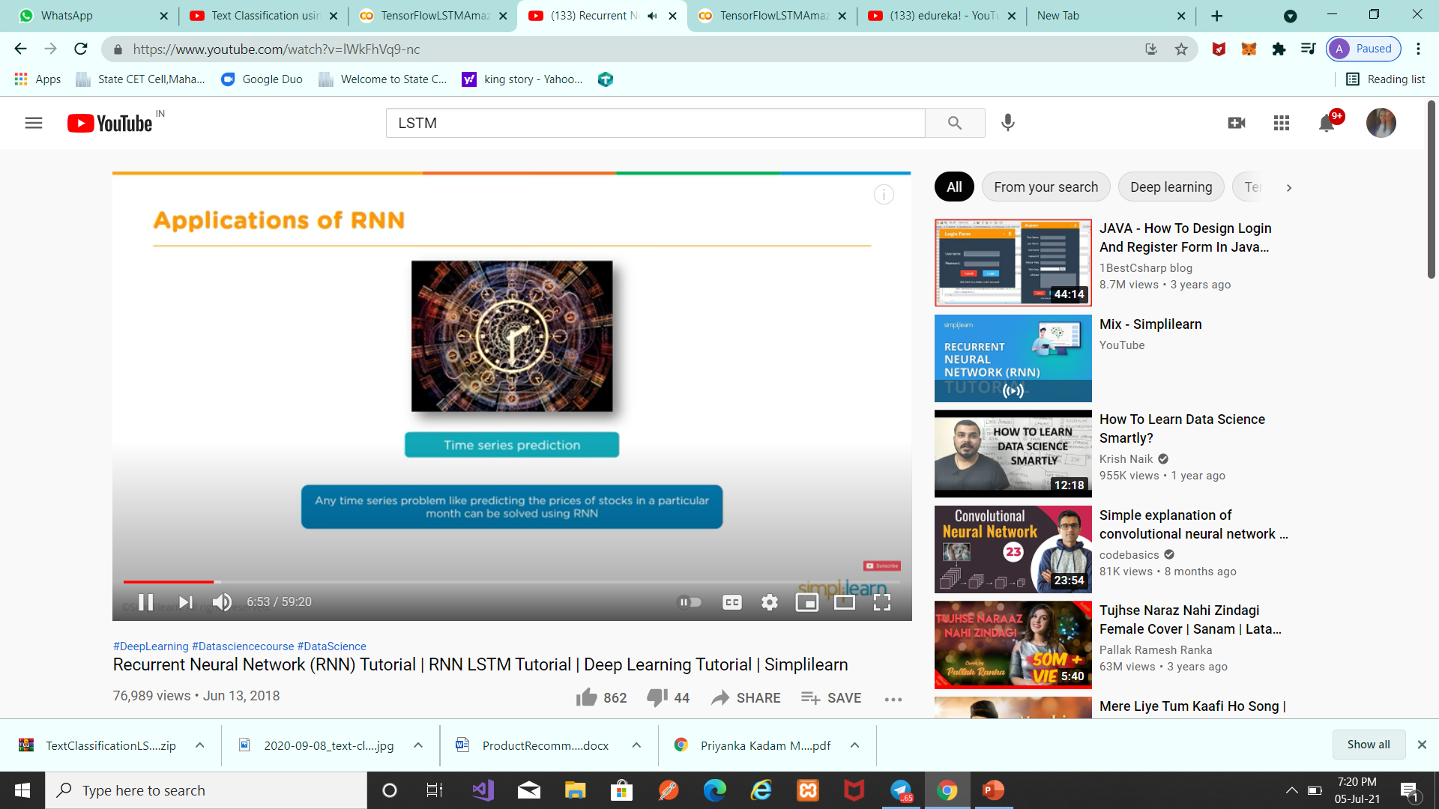
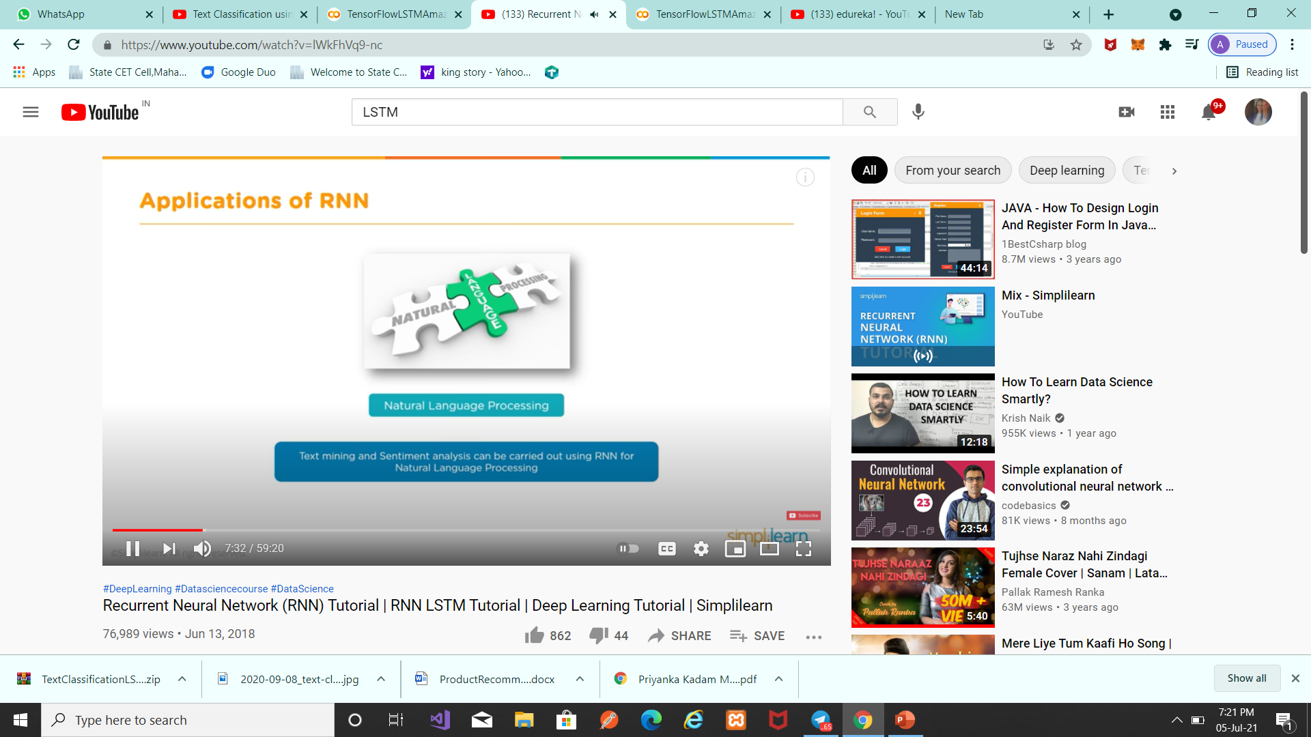
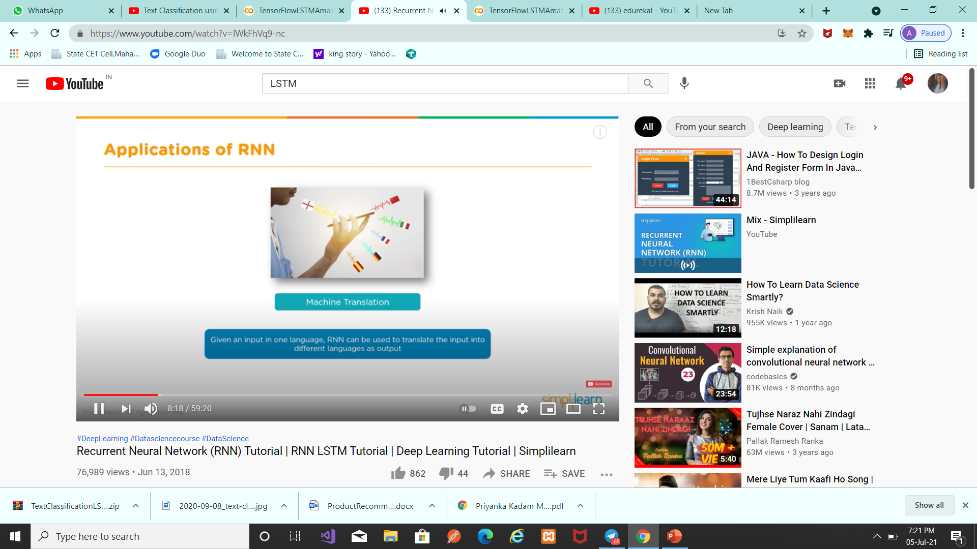
Application of RNN

Slide 13
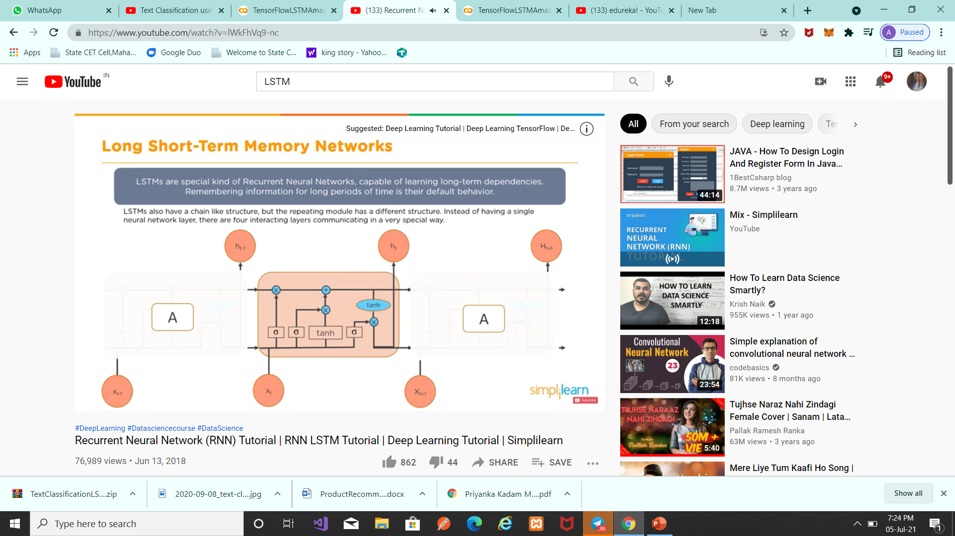
Long Short – Term Memory Networks (LSTM)

Slide 14
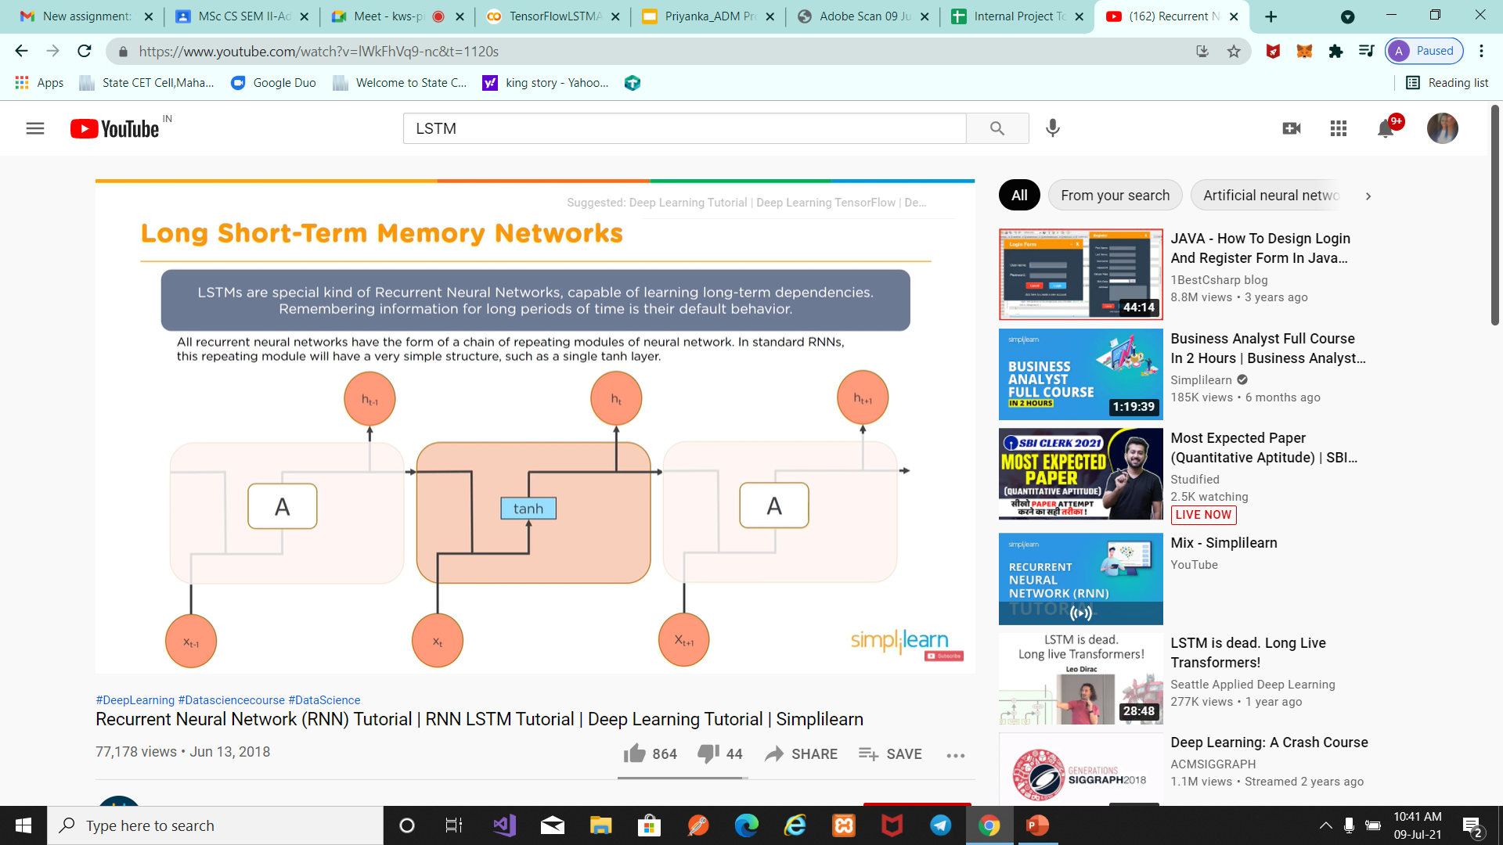
LSTM

Slide 15
LSTM
For example, LSTM is applicable to tasks such as
unsegmented,
connected handwriting recognition,
speech recognition
and anomaly detection in network traffic or
IDSs (intrusion detection systems).

